Slide 1
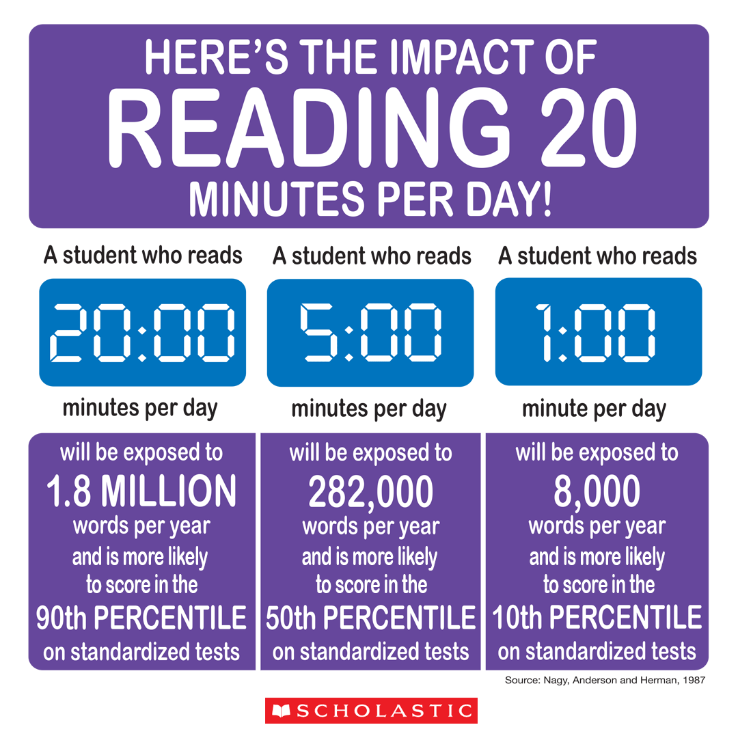
Bastrop Intermediate School
6th Grade English Language Arts
Mrs. Eckman - 2019-2020
Welcome to 6th grade ELA! I am excited to have your child in my class this year and look forward to getting to know you and your child better. I am eager to partner to ensure your child reaches their full potential.
The following outline is to help you understand what your child will focus on throughout this school year. We will focus on the following areas:
Year At a Glance
8/14-9/4 Unit 1: Launching Strong Literacy Habits
9/5-10/4 Unit 2: Exploring and Crafting Fiction: Contemporary & Traditional Literature
10/7-11/22 Unit 3: Exploring and Crafting Informational Text
12/2-12/19 Unit 4: Research-based Synthesis, Creation and Innovation
1/7-1/24 Unit 5: Analyzing and Crafting Poetry
1/27-2/7 Unit 6: Reading and Performing Drama
2/10-3/13 Unit 7: Analyzing and Crafting Argumentative Texts
3/2-5/8 Unit 8: Making Connections Across Genres & STAAR Review
5/11-5/27 Unit 9: Synthesize! Create! Innovate!
In order to support your child’s learning, I ask that you ensure he or she:
Arrives to class with the necessary supplies and ready to work
Completes their book projects and other assignments on time
Informs you (or myself) if additional support is needed
Reads at least 20 minutes each day outside of school
Evaluation
Student progress will be assessed by class participation, in-class assignments, homework assignments, journals, book projects, quizzes, tests and projects. Each 6 weeks students will have a minimum of 3 major grades and 7 daily grades.
Daily Grades: 40% (at least 7 per grading period)
Major Grades: 60% (at least 3 per grading period)
Reading
Students will be responsible for reading outside of class. Studies show that students who read just 20 minutes per day will set themselves up for success compared to non-readers. I look forward to partnering with you to encourage reading and ensuring your student has books that interest them.
Book Projects
Students will be given the opportunity to complete one book project each 6 week grading period. Students will be able to use a book of their choice to complete each project. Details about each project will be provided at the beginning of each grading period and projects will be due toward the end of each 6 week grading period. Completed book projects will count as a major grade.

Slide 2
Supplies: In order to accomplish all of our learning goals this year, your child will need the following school supplies. Please have your child bring these supplies to class by Friday, August 16th.
Per the BISD supply list, students should bring:
2 Single subject spiral notebooks
2 Composition notebooks
8 Glue sticks
3 Crayola colored pencils (12 ct.)
1 5” scissors (sharp point)
2 boxes Facial tissue
2 pkg. College ruled notebook paper
48 #2 pencils
2 Large erasers
4 Pocket folders with brads
1 Zippered pencil pouch
1 pkg. Highlighters
1 box Reclosable sandwich bags
1 Disinfecting wipes
In addition to the supply list provided by the BISD district website, the following supplies will be needed for ELA:
1 Package of index cards
2 Packages of post-it notes
1 pkg. Thin dry erase markers (preferably black)
1 pair Headphones
Class Targets:
We act in a manner that is safe, respectful, and responsible at all times.
We follow rules the first time they are given.
We come to class prepared with supplies and ready to learn.
Consequences for Unacceptable Behavior
1st Offense - Warning
2nd Offense - Student Conference
3rd Offense - Lunch/Recess Detention
4th Offense - Parent Contact
5th Offense - Parent/Teacher Conference
6th Offense - Office Referral
Communication
-Please contact me at any time throughout the year with any
questions, comments or concerns you may have. As I will be with
students the majority of the day, email is the best way to get in
contact with me. You may also call and leave a voicemail. Please be
aware that I will return your call as soon as possible.
Phone: 512-4-3310
Email: eeckman@bisdtx.org
-Throughout the year I will communicate with you using Remind and
our class Google Classroom where assignments and projects will be posted.

